Slide 1
Building your own applications using .NET Bio

Slide 2
Information in this document is subject to change without notice. The example companies, organizations, products, people, and events depicted herein are fictitious. No association with any real company, organization, product, person or event is intended or should be inferred. Complying with all applicable copyright laws is the responsibility of the user.
Microsoft may have patents, patent applications, trademarked, copyrights, or other intellectual property rights covering subject matter in this document. Except as expressly provided in any license agreement from Microsoft, the furnishing of this document does not give you any license to these patents, trademarks, or other intellectual property.
© 2011 Microsoft Corporation. All rights reserved.
Microsoft, MS, Windows, MSDN, Visual Basic, Visual C++, Visual C#, and Visual Studio are either registered trademarks or trademarks of Microsoft Corporation in the U.S.A. and/or other countries.
Other product and company names herein may be the trademarks of their respective owners.
Microsoft Biology Initiative Training by Microsoft Corporation is licensed under a Creative Commons Attribution 3.0 Unported License. Based on a work at research.microsoft.com/bio.

Slide 3
Agenda
.NET Bio Architecture
Sequences, alphabets and symbols
Parsers and formatters
Introduction to algorithms
.NET Bio Starter Project
Creating a new C# project
.NET Bio Source Code
Building the source
Testing

Slide 4
.NET Bio Design Goals
Extensibility was a primary goal
core concepts mapped as interfaces and abstract classes
can easily provide alternative implementations or add any missing features you need
Language Neutral
built on top of .NET – use any supported language (C++, F#, …)
supports dynamic languages such as IronPython
Designed and implemented using best practices
commented source code provided so nothing is a black box
algorithms all cite publications
Interoperability
code can be run on several mainstream platforms

Slide 5
.NET Bio vs. your application
.NET Bio is a set of tools used to build applications
it does not provide any visualization of the data being managed
it provides the basis for visualizations to be built on top of
Your Application
.NET Bio
.NET Framework 4.0

Slide 6
Creating Applications with .NET Bio
.NET Bio allows you to work with your data however you need
Console (Text)
Win Forms & WPF
ASP.NET / WCF
Silverlight
Azure
NT Service
Can be used in any application style

Slide 7






Deploying your applications
Possible to target non-Windows platforms^{[1]}
using Silverlight / Mono / Moonlight
Notes:
[1] To use .NET Bio in other environments, you will use Silverlight as your application style and then rely on Mono/Moonlight or the Silverlight plug-in on the OSX platform to run your code. You can still use Visual Studio for your IDE on the Windows platform, or if you are willing to work with the source code, you can use a Mono-based IDE such as MonoDevelop or SharpDevelop.

Slide 8
Architecture: Namespaces
Bio
Sequences
Alphabets
Bio.IO
Translation
Bio.Web
BLAST
Alignments
Genomic Intervals
Phylogeny
Sequence Assembly
ClustalW
BioHPC
FASTA / FASTQ
GenBank
NEXUS
Bio.Algorithms
…
…
…
Alignment
Notes:
We will look at Bio, IO and Algorithms here – and save Web for later.

Slide 9
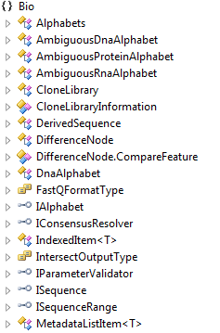
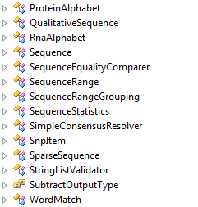
.NET Bio Core Types
Bio namespace holds core types and base interfaces

Slide 10
Alphabets
Valid symbols are defined in terms of an alphabet
determines allowed characters and meaning
Access standard alphabets through Instance properties
supplies standard alphabets for DNA, RNA and protein sets
can also access them using Alphabets static class
Or create custom alphabets if necessary
by implementing the IAlphabet interface
var dnaAlphabet = DnaAlphabet.Instance;
...
var dnaAlphabet2 = Alphabets.DNA;
These two statements retrieve the same alphabet

Slide 11
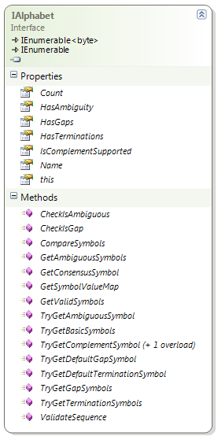
Alphabet details
IAlphabet contains alphabet details
provides access to valid symbols
also has methods for alphabet analysis
var alphabet = DnaAlphabet.Instance;
Console.WriteLine("{0}, T:{1}, G:{2}, A:{3}",
alphabet.Name,
alphabet.HasTerminations,
alphabet.HasGaps, alphabet.HasAmbiguity);
Dna, T:False, G:True, A:False

Slide 12
Alphabet elements
Symbols are stored as bytes for efficiency
IAlphabet implements IEnumerable<byte> for iteration
also includes direct indexer to access by position
var alphabet = Alphabets.DNA;
foreach (byte value in alphabet)
{
Console.WriteLine("{0}: [{1}] {2} {3}", value, (char)value, alphabet.CheckIsAmbiguous(value), alphabet.CheckIsGap(value));
}
65: [A] False False
67: [C] False False
71: [G] False False
84: [T] False False
45: [-] False True

Slide 13
Representing Sequences
ISequence interface represents ordered list of sequence values
store data relevant to DNA, RNA and Amino Acid structures
work with sequence as a enumerable set of items (bytes)
public interface ISequence : IEnumerable<byte>
{
string ID { get; }
int Count { get; }
IAlphabet Alphabet { get; }
byte this[long index] { get; }
...
}

Slide 14
Sequence Implementations
Several ISequence implementations in the framework
each optimized for a specific purpose, most common is Sequence
Sequence Type | Description
Sequence | Standard implementation for managing a sequence.
DerivedSequence | Maintains original source sequence along with changes.
QualitativeSequence | Stores sequence items and quality score (Sanger, Solexa, Illumina).
SparseSequence | Sequence composed of discontinuous fragments from a longer sequence. Useful if you only want to work with portions of a long sequence.

Slide 15
Creating new sequences
Sequence type is most basic ISequence implementation
always read-only
must supply string or byte array to constructor to initialize
Sequence stores data as byte array internally
each item has ASCII value of symbol – can cast to char
ISequence sequence = new Sequence(Alphabets.DNA, "A-G-CT");
string sequenceData = new string(
sequence.Select(b => (char)b).ToArray());
Console.WriteLine(sequenceData);
A-G-CT
here we create a new string to display the entire sequence
Notes:
There is a ConvertToString method on the Sequence type which will do the above more efficiently, however it is not present on ISequence so you have to know it’s a Sequence type which makes it not as useful as it sounds.

Slide 16
Reading and writing sequences
Most common way to obtain a sequence is through a parser
loads sequence data from some persistent storage
tied to a specific format
can load one or more sequences together
can support metadata and statistics for sequence
Once loaded, sequence can be processed
through methods of ISequence, or by algorithms
Finally, sequences are saved using formatters
writes collection of ISequence objects to persistent storage
.NET Bio has several available parsers and formatters^{[1]}
contained in the Bio.IO namespace
designed for extensibility – to support your formats
Notes:
[1] .NET Bio actually has a host of parsers/formatters built in. We will focus on a couple here, and look at the remainder later.

Slide 17
Loading sequences with parsers
Several supplied parsers load common bio sequence formats
FastA, FastQ, GenBank, Gff
All sequence parsers implement ISequenceParser
provides consistent interface to parsing data
supports loading data from files (more on this later)
public interface ISequenceParser : IParser
{
string Name { get; }
string Description { get; }
string SupportedFileTypes { get; }
IAlphabet Alphabet { get; set; }
void Open(string filename);
IEnumerable<ISequence> Parse();
IEnumerable<Isequence> Parse(StreamReader reader);
void Close();
}

Slide 18
Loading data from specific formats
If file format is known, specific parser can be used to load data
easiest and least error prone method to loading data
private IEnumerable<ISequence> LoadSequence(string filename) {
FastAParser parser = new FastAParser(filename);
IEnumerable<ISequence> data = parser.Parse();
return data; }
constructor takes optional parameter to set the filename during the construction of the parser – however it is not read until the Parse method is called
Parse lazy loads the data – make sure to at least fetch one record before closing the parser object or an exception will result

Slide 19
Handling multiple file formats
SequenceParsers class manages built-in parser types
use FindParserByFileName to locate parser from filename
can also identify specific parser by name (FindParserByName)
private IEnumerable<ISequence> LoadSequence(string filename) {
ISequenceParser parser =
SequenceParsers.FindParserByFileName(filename);
if (parser == null)
return null;
return parser.Parse();
}
FindParserByFile[Name] returns null if file could not be identified^{[1]}
Do not call Open() on the parser if you use this method – it is already open!
Notes:
[1] This can happen more often than you might think – the test done today is to check the known file extensions; if the file has an uncommon extension it might not be properly recognized.

Slide 20
Saving sequences back to files
Formatters take sequences and persists them
same formats supported: FastA, FastQ, GenBank and Gff
Abstracted by ISequenceFormatter interface
supports file or stream-based storage for 1+ sequences
public interface ISequenceFormatter : IFormatter
{
void Open(string filename);
void Open(StreamWriter writer);
void Write(ISequence sequence);
void Close();
}

Slide 21
Saving a sequence
SequenceFormatters provides list of available formatters
void SaveSequence(string filename, IEnumerable<ISequence> seqList) {
ISequenceFormatter formatter =
SequenceFormatters.FindFormatterByFileName(filename);
if (formatter != null)
{
foreach (var sequence in seqList)
formatter.Write(sequence);
formatter.Close(); }
}

Slide 22
Saving a sequence
SequenceFormatters includes access to built-in formatters
static properties expose known formatters
can also create new instances of formatters (of course)
void SaveFastASequence(string fname, IList<ISequence> seqList) {
ISequenceFormatter formatter = SequenceFormatters.Fasta;
formatter.Open(fname);
foreach (var sequence in seqList)
{
formatter.Write(sequence) }
formatter.Close(); }

Slide 23
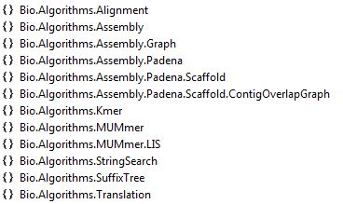
Running algorithms on Sequences
.NET Bio provides a small collection of popular algorithms
alignment, translation, assembly, …
designed specifically to plug in new algorithms
Bio.Algorithms is where all the algorithmic code is located
each algorithm is given unique namespace
can also be supplied in separate assemblies that .NET Bio locates and provides access to at runtime^{[1]}
…
Notes:
[1] This allows more complex algorithms to be segregated to their own assemblies and only included when used/required. It also allows for easier versioning. .NET Bio will locate and make available the algorithms

Slide 24
Using the algorithm classes
Algorithms generally
take one or more ISequence elements as input and return one or more ISequence elements as output
Algorithms come in two forms
static methods – to run simple algorithm on a single sequence
instance classes – to run algorithms on 1+ sequences
using Bio.Algorithms.Translation;
...
ISequence DNAtoRNA(ISequence dnaSequence) {
ISequence rnaSequence = Transcription.Transcribe(dnaSequence);
return rnaSequence;
}

Slide 25
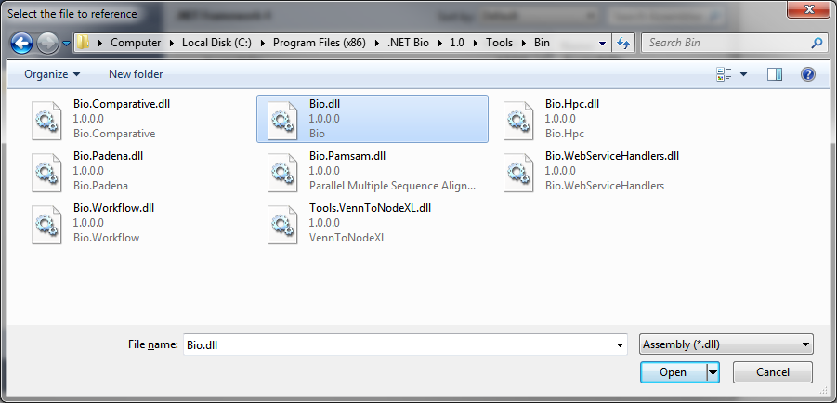
Using .NET Bio in your applications
Using .NET Bio is as simple as adding a reference to Bio.dll
can then begin consuming available types
convenient to add assembly to project – to ensure it is available
supplied distribution requires the full .NET 4.0 framework install

Slide 26
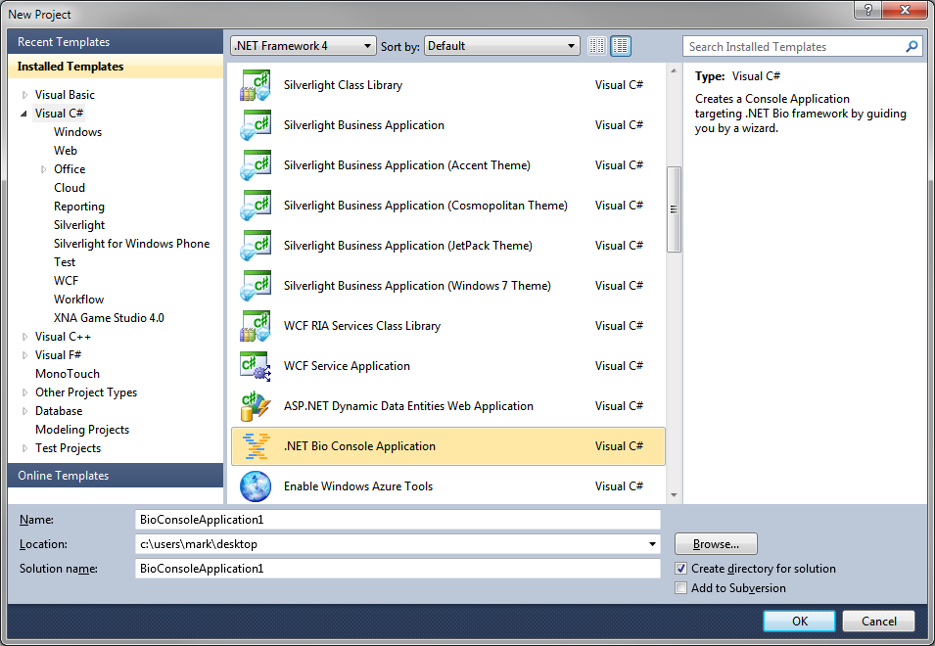
.NET Bio Starter Project [Step 1]
If you are starting fresh, you can use the .NET Bio Starter Template
added to Visual Studio 2010 when you installed .NET Bio
requires .NET Framework 4 and Visual C# project type selected
Select .NET Bio Console Application from project types

Slide 27
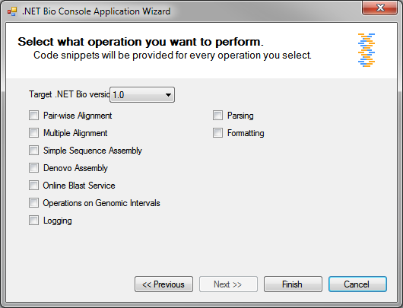
.NET Bio Starter Project [Step 2]
Select options you want to use from .NET Bio in your new app
each checkbox will add standard methods for you to utilize
provides simple text-file logging capability
… click Finish to generate project

Slide 28
.NET Bio Starter Project [Step 3]
Add your code to the Main method
call the supplied methods to get / save and manipulate the sequences
class Program
{
static void Main(string[] args)
{
// TODO: Your Code Goes Here
}
// Exports a given sequence to a file in FastA format
static void ExportFastA(ISequence sequence, string filename);
// Parses a FastA file which has one or more sequences.
static IEnumerable<ISequence> ParseFastA(string filename);
// Write a given string to the application log.
static void WriteLog(string matter);
// Method to align two sequences using NeedlemanWunschAligner.
public static IList<IPairwiseSequenceAlignment> AlignSequences(
ISequence referenceSequence, ISequence querySequence)
}

Slide 29

Contributing back to .NET Bio
.NET Bio is an open source project
needs your ideas, contributions and feedback
Go download the source code
read through to get good coding practices
extended or repurpose for your projects
Consider contributing changes / features back to the project
allow others to benefit from your work and research!

Slide 30
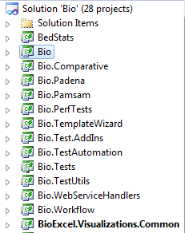
Examining the Source Code
Can retrieve source code from http://bio.codeplex.com
individual files or as self-contained .zip file
Solution Bio.sln contains all projects
Bio – core library
Bio.Workflow
Bio.WebServiceHandlers
Unit tests
Sample SDK code

Slide 31
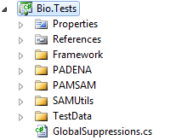
Unit Testing
.NET Bio includes suite of unit tests for all components
uses Visual Studio unit test framework
test cases are in separate unit-test assemblies
any contributions to codebase must include unit tests

Slide 32
Writing your own unit tests
Unit tests are just blocks of code written to test other code
tests assumptions, edge cases, error cases, and functionality
Visual Studio makes writing test cases easy
uses .NET attributes to signal intent
Assert class provides helper methods to test assertions
identifies this as a unit test class
[TestClass]
public class ReverseTests
{
[TestMethod]
public void TestReverse()
{
Sequence sequence = new Sequence(Alphabets.DNA, "AGCT");
Seqeucen reverse = sequence.GetReversedSequence();
Assert.AreEqual((byte)'T', reverse[0]); }
}
identifies this as a unit test method
verifies the first character is the last character in the original sequence

Slide 33
Summary
.NET Bio framework is used to build bioinformatics applications
open source
highly extensible
scalable
flexible data architecture
Based on .NET
language agnostic
allows any application style
can use all the power and flexibility of .NET
Sequences are the core concept in the framework
contain sequence items [symbols]
based on alphabets
read/written using parsers/formatters
passed as arguments and returned from algorithms

Slide 34
Disclaimer: This document is provided "as-is". Information and views expressed in this document, including URL and other Internet Web site references, may change without notice. You bear the risk of using it.
This document does not provide you with any legal rights to any intellectual property in any Microsoft product. You may copy and use this document for your internal, reference purposes.
© 2011 Microsoft Corporation. All rights reserved.
Microsoft, Visual Studio, and Windows are trademarks of the Microsoft group of companies. All other trademarks are property of their respective owners.

